Slide 1
Project Presentation
Spatial Pattern Analysis of EV Charging Stations in R
Presented by Srishti Roy Chowdhury
Date- April 29, 2025

Slide 2

Background and Literatures
Experienced transportation issues dealing with congestion, noise, and pollution in daily life, some factors contributing to the non-sustainable transport systems are diminishing petroleum reserves, global atmospheric impact, air quality, injuries and fatalities, etc.
Surprisingly, the transportation sector is responsible for almost one-third of greenhouse gas emissions, causing climate change (Black, 2010).
The transportation sector is critical to the American economy, resulting in offering funds for R&D each year to advance technologies that improve the sustainability, affordability, and efficiency of all modes of transport by EERE.
EERE also partners with other agencies, such as the DoT, HUD, and EPA, to advance sustainable transportation. There is also a special department named the Joint Office of Energy and Transportation (U. S. DoE, n.d.).
Notes:
As a citizen of a country like Bangladesh, where transportation is one of the major concerns, I have always been interested in working in this sector. It is not an issue of country only; every country is working on making their transportation sustainable.

Slide 3
Background and Literatures
Electric Vehicles (EVs) are a groundbreaking invention in the transportation sector due to their technical intelligence, environment-friendly nature, and intention of promoting public health by contributing to a resilient and sustainable transport system (U. S. DoE, n.d.).
However, the promotion and use of electric vehicles, especially in long-distance travel, is restricted to a certain extent because of their limited range and the lack of proper distribution of charging stations, resulting in range anxiety of users, which is related to the range accessibility to EVCS (Pevec, 2020).
So, it becomes important to assess the problem in order to provide a better understanding to developers and policymakers.

Slide 4
Background and Literatures
Some studies addressed the benefits and challenges related to EVs, such as purchasing cost, battery life & cost, charging time, cost & compatibility.
For the past few years, the placement of charging stations has drawn the attention of researchers as the issues regarding range anxiety and driving range (Deb et al., 2018).
Mostly followed three approaches: DNO, CSO & EDA, and applied various mathematical algorithms, models, and techniques, and several studies have also been conducted in various countries, exploring the optimal locations for EVCS utilizing various tools of ArcGIS and QGIS (Ahmad et al., 2022).

Slide 5
Research Questions
How are EV charging stations spatially distributed? Is there any disproportionate distribution in charger type, accessibility?
Is there any regional variation in the spatial distribution patterns? If so, what could be the key geospatial determinants of these patterns? (e.g., demography, land cover, road density, etc.)
Objectives:
To assess the density and distribution of charging stations throughout the United States
To explore the distribution patterns among regions, identifying the geospatial determinants of those patterns (if any)

Slide 6
Intro to key words
EV types- BEV (Battery EV), HEV (Hybrid EV), PHEV (Plug-in hybrid EV)
EVCS- EV Charging System: entire charging station, including the chargers, payment system, and underlying infrastructure
EVSE- Electric Vehicle Supply Equipment: charging points/chargers.

Slide 7
Methodology
Study Area
United States, excluding Alaska, Hawaii
To explore regional variation, state-wise analysis will be conducted
Hardware & Software Support
Laptop
R
Collection of data and maps from secondary sources
Spatial analysis-based research utilizing R

Slide 8
Methodology
List of Data and Analysis for Q1:
Question | Data | Data Type | Source | Analysis
How are EV charging stations spatially distributed? Is there any disproportionate distribution in charger type, accessibility? | List of stations & geospatial location with types | .csv file | US Department of Energy | Libraries- tidyverse, dplyr, tmap, SpatialKDE, ggplot2 Use- intersection, making graph, plotting map, wide to long data conversion, table generation
 | Vehicle registration | .csv file | Bureau of Transportation Statistics
 | Administrative boundary map | Shapefile (polygon) | USGS National Map

Slide 9
Methodology
List of Data and Analysis for Q2:
Question | Data | Data Type | Source | Analysis
Is there any regional variation in the spatial distribution patterns? If so, what are the key geospatial determinants of these patterns? (e.g., land cover, road density, demography, etc.) | EV charging station locations | Shapefile (point) | US Department of Energy | Libraries- tidyverse, dplyr, tmap, sp, terra, Use- dynamic and static map creation,
 | Road Network map | Shapefile (line) | USGS National Map
 | Administrative boundary map | Shapefile (polygon) | USGS National Map
 | Landcover map | Raster | USGS National Land Cover Database
 | Population Density/EV Users’ data | .csv file | US Census Bureau, US Department of Transportation
 | State-wise GDP | .csv file | BEA

Slide 10
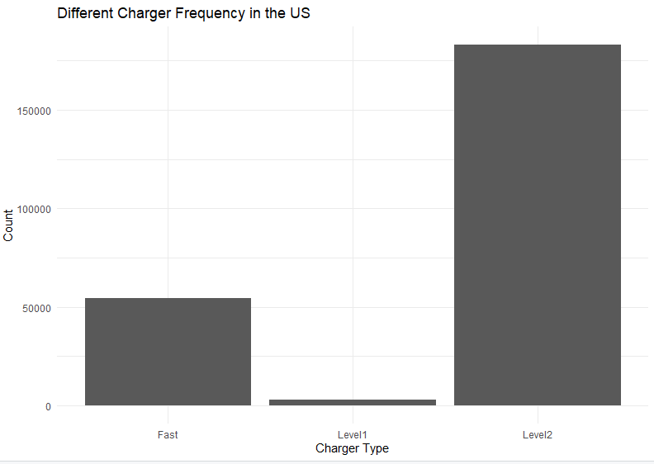
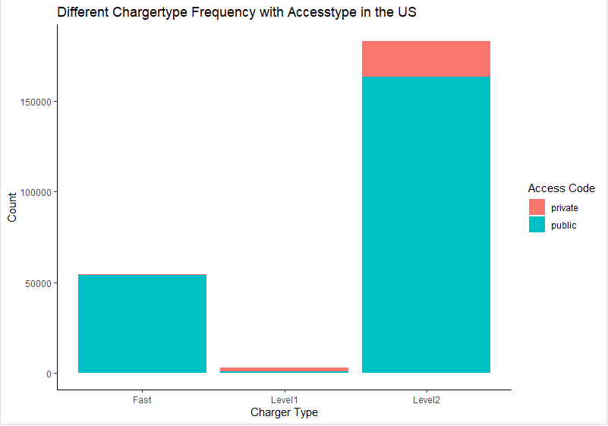
Findings- EVSE
Charger Type: Level 1, Level 2, and Direct Current Fast Charging (DCFC), also known as Level 3
 | Level 1 | Level 2 | DCFC (Level 3)
Locations | Home | Home, Workspace, Public | Public
Voltage | 120 V AC | 208 - 240 V AC | 400 V - 1000 V DC
Est. Range/ hour of Charging | 2 - 5 miles | 10 - 20 miles | 180 - 240 miles
BEV (80%) | 40- 50+ hours | 4-10 hours | 20min- 1hour
PHEV | 5-6 hours | 1-2 hours | Not compatible
Notes:
Does it affect the adoption of EV?

Slide 11
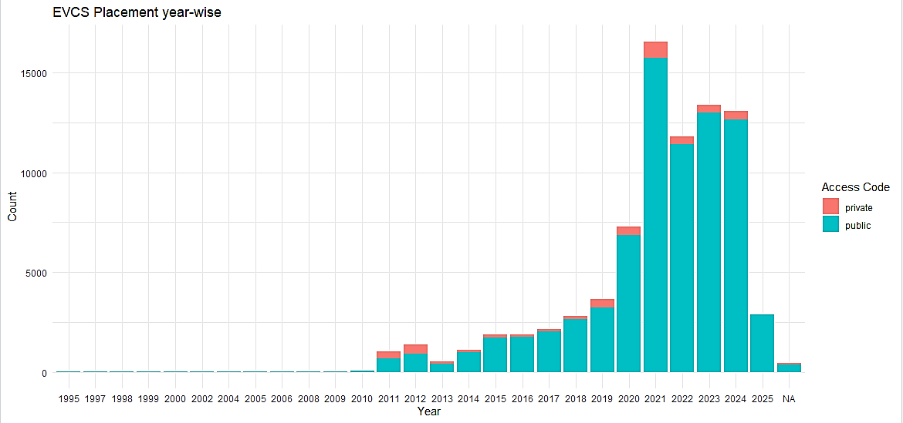
Findings- EV Registration and EVCS Establishment
Notes:
Does the establishment of EVCS follow the trend of adoption of EVs?

Slide 12
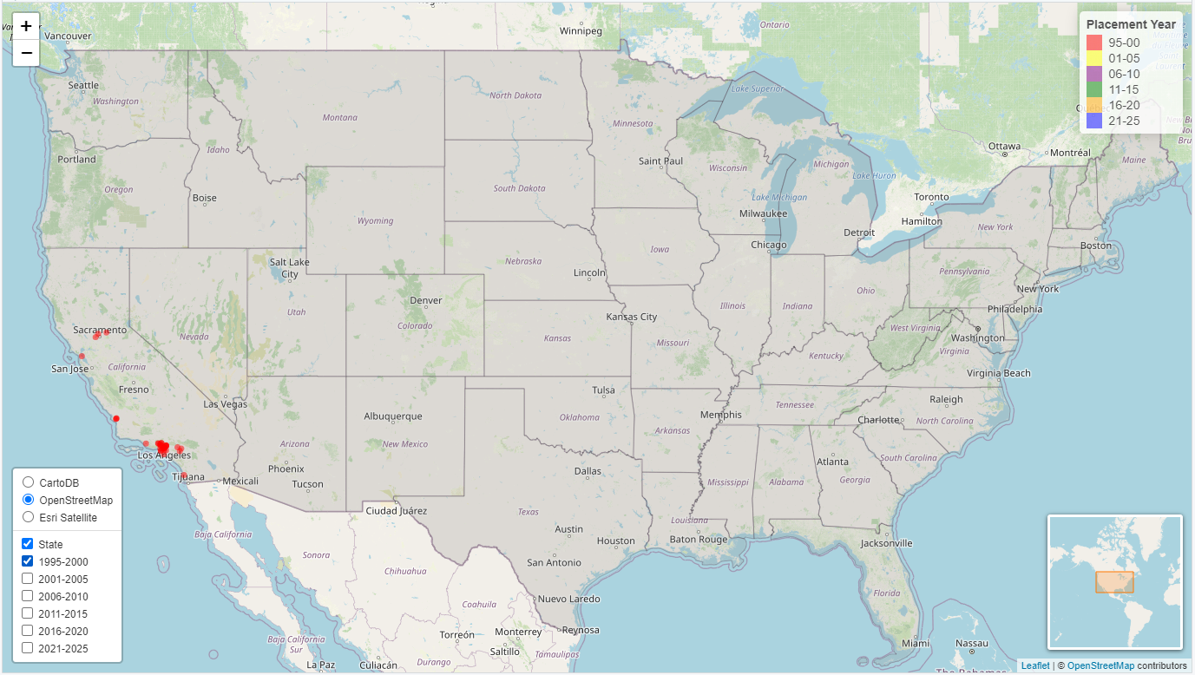
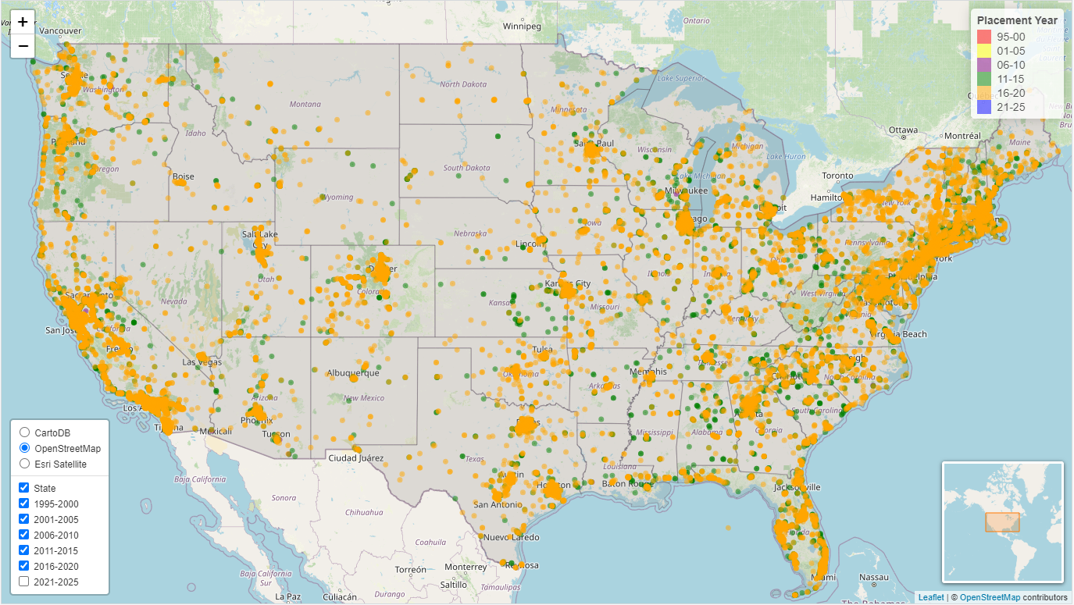

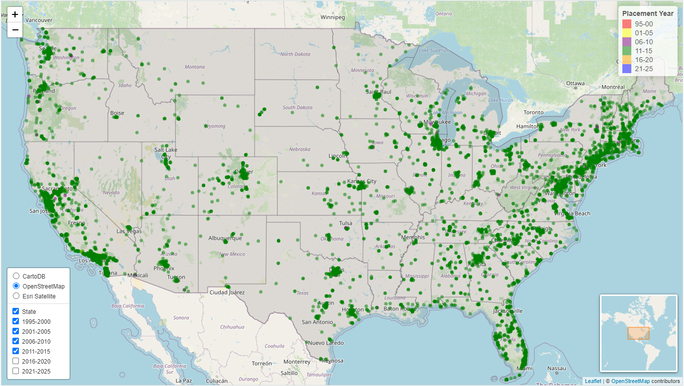
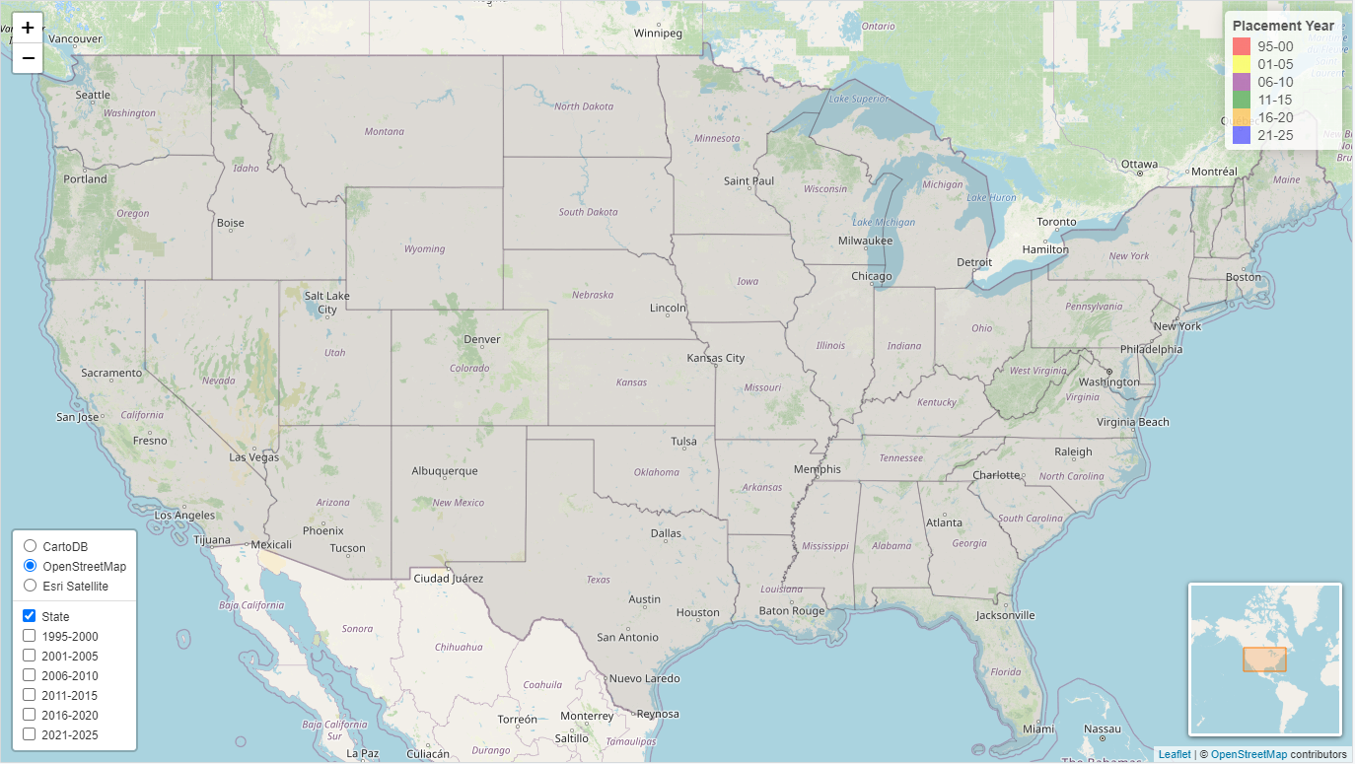

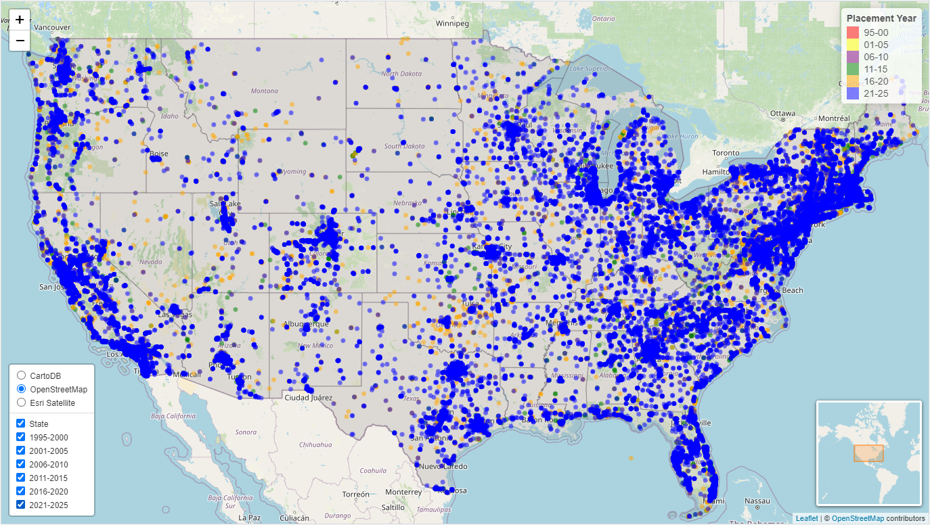
Notes:
Now let’s look into the spatial changes, where those changes happened over time.

Slide 13
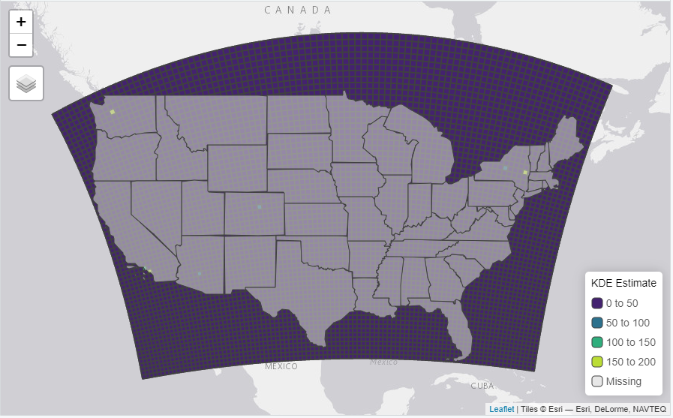
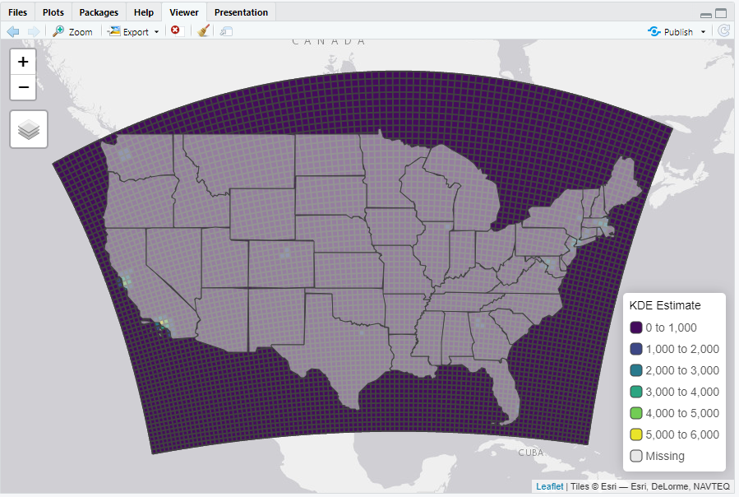
Findings- EVCS Density Modelling
Kernel Density Model with two different cell size and band with
Density Maps

Slide 14
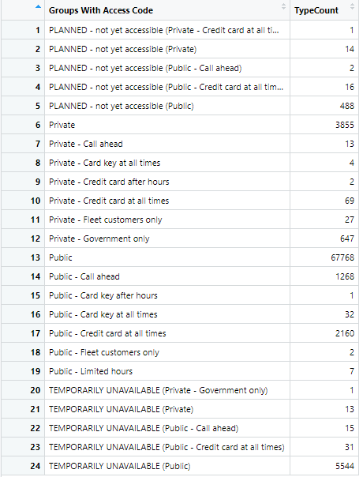
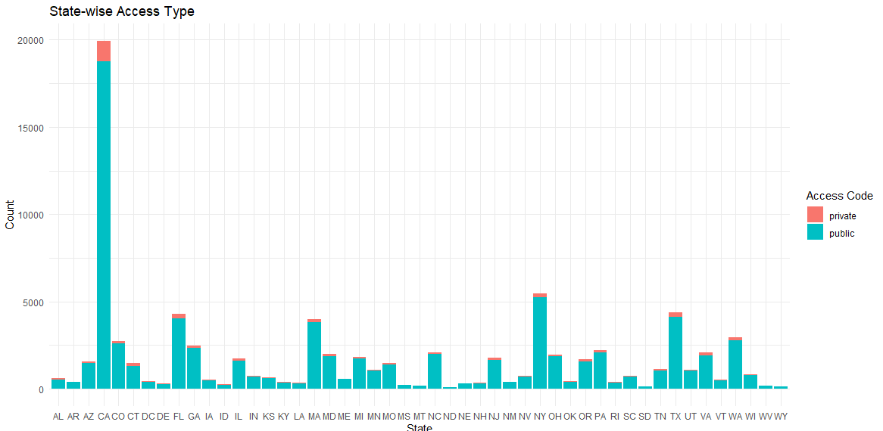
Findings- EVCS Accessibility
Access Type- Public and Private (in some cases, to some extent)

Slide 15
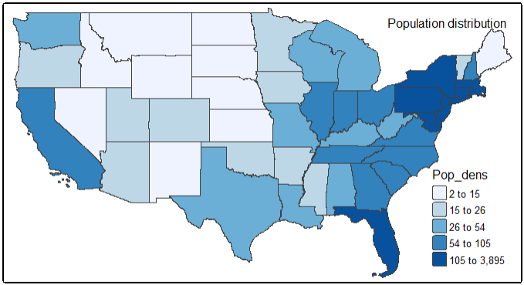
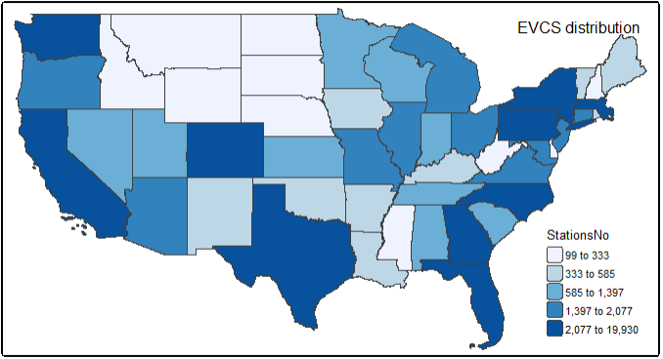
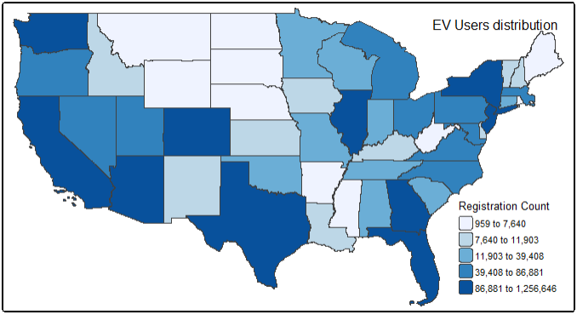
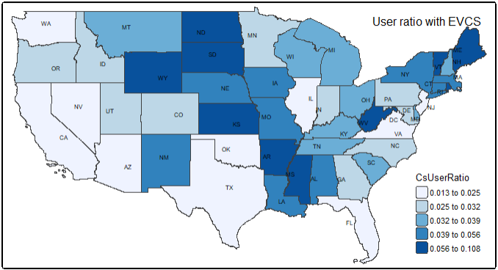
Findings- Regional Variation
Notes:
Quantile, why that? Bcz too skewed distribution while using equal and others
Similarity between the user and evxcs but No match between the pop dens with others. Surprisingly no match with the ration. Q-why the ration is so high in those place where neither the pop high nor the user?

Slide 16
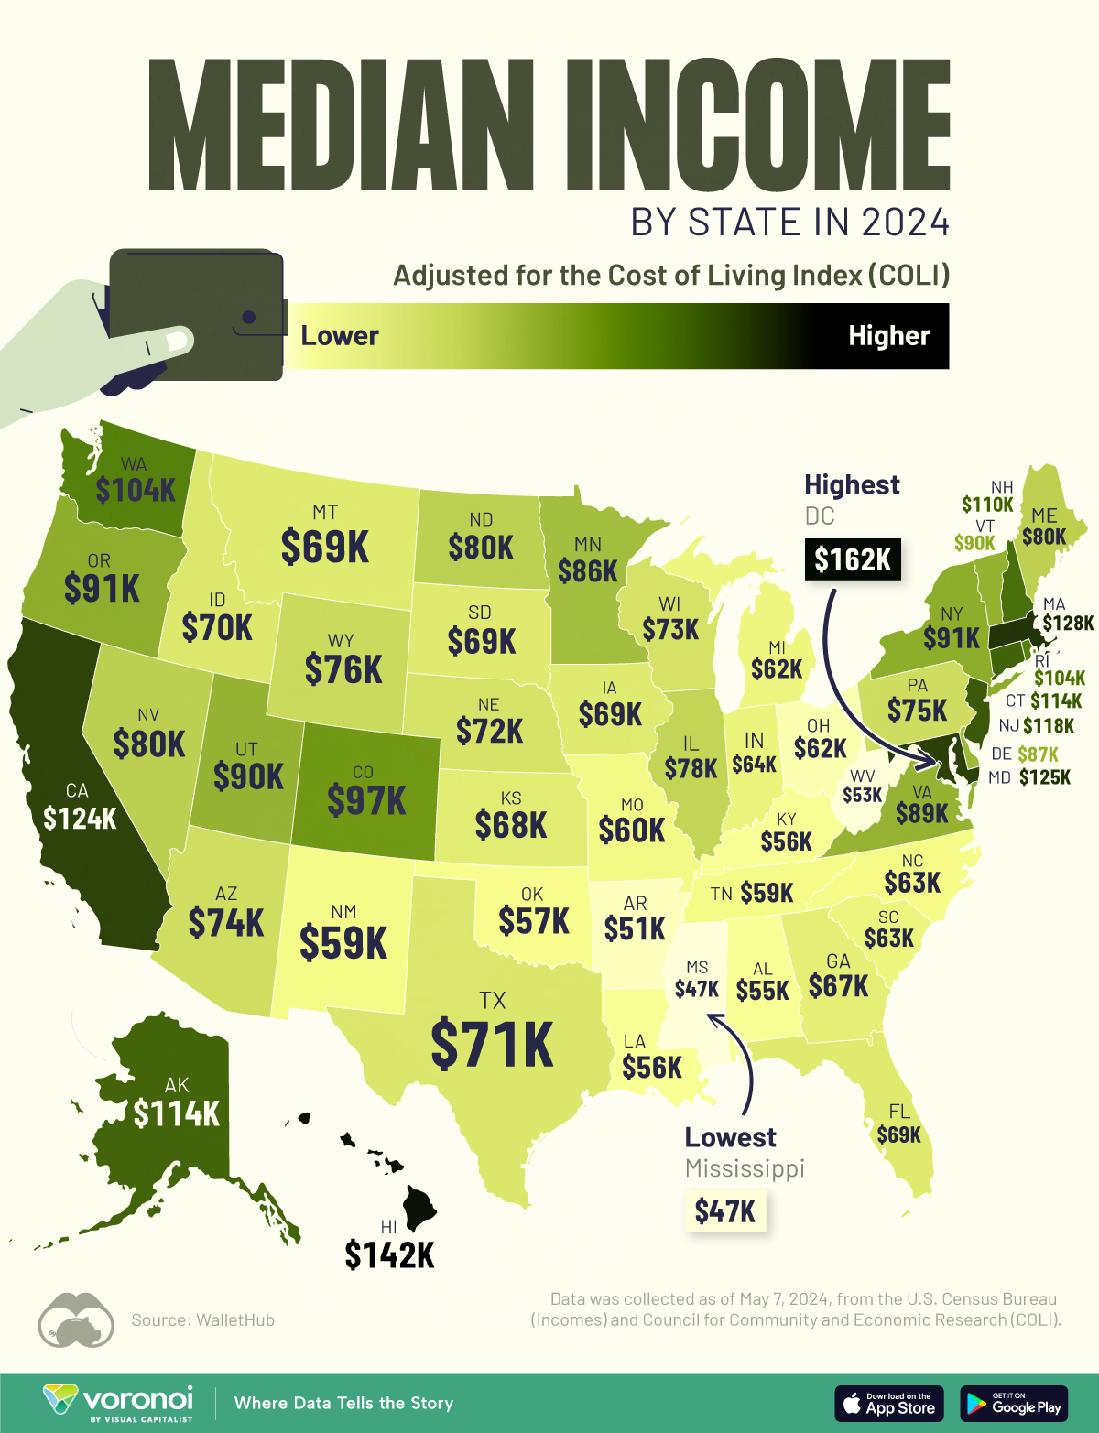
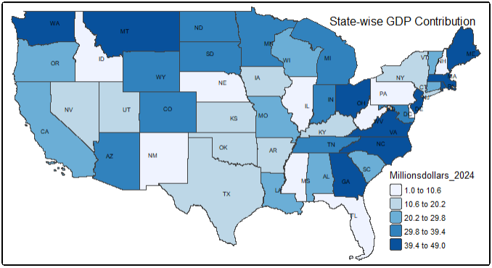
Findings- Regional Variation
Notes:
Quantile, why that? Bcz too skewed distribution while using equal and others
Similarity between the user and evxcs but No match between the pop dens with others. Surprisingly no match with the ration. Q-why the ration is so high in those place where neither the pop high nor the user?

Slide 17
Success Factor (Expectation Vs Reality)
Assessing the density and distribution of charging stations throughout the regions.
Successful, although the output of KDE didn’t meet the expectation.
Exploring the regional variation and finding the geospatial determinants (demography, landcover, road density).
Successful while working with demographics. Failed to incorporate other variables.
Initial idea was working on the thesis questions and be prepared beforehand.
Failure came with lots of background knowledge and ideas for methodology development.
Working with R
Fully succeed utilizing R to produce maps and graphs.

Slide 18
Challenges & Learning
Long waiting time to load data and run code due to file size or wrong selection of study area.
Be more careful when selecting a study area.
So many things to explore, add, and show, hard to decide what to ignore and what needs more focus.
Working on a more specific area.
R’s environment memory issue
Be prepared beforehand, efficient use coding and data.
Datasets of different time frames
Finding more compatible datasets or organizing/cleaning the existing datasets

Slide 19
Further Implications
Understanding the background of the research area will help to select the specific work area and study area.
Strong technical knowledge, especially dealing with sudden challenges
Understanding of Dos and don’ts
Future Goals
Finding potential placements of EVCS
Optimal route analysis for EVs in long-distance travel
Increasing critical thinking

Slide 20
References
Ahmad, F., Iqbal, A., Ashraf, I., Marzband, M., & khan, I. (2022). Optimal location of electric vehicle charging station and its impact on distribution network: A review. Energy Reports 8, 2314–2333. DOI: 10.1016/j.egyr.2022.01.180
Black, W. R. (2010). Sustainable Transportation: Problems and Solutions. The Guildford Press.
Deb, S., Tammi, K., Kalita, K., & Mahanta, P. (2018). Review of recent trends in charging infrastructure planning for electric vehicles. Wiley Interdisciplinary Reviews: Energy and Environment, e306. DOI:10.1002/wene.306
Pevec, D. (2020). A survey-based assessment of how existing and potential electric vehicle owners perceive range anxiety. Journal of Cleaner Production, 276. DOI: 10.1016/j.jclepro.2020.122779
U.S. Department of Energy (n.d.). Electric Vehicle Benefits and Considerations. Alternative Fuels Data Center. https://afdc.energy.gov/fuels/electricity-benefits
U.S. Department of Energy (n.d.). Transportation & Fuels Pillar. https://www.energy.gov/eere/transportation-fuels-pillar

Slide 21
Thank You!!!

